Slide 1
Defending Against Buffer-Overflow Attack

Slide 2
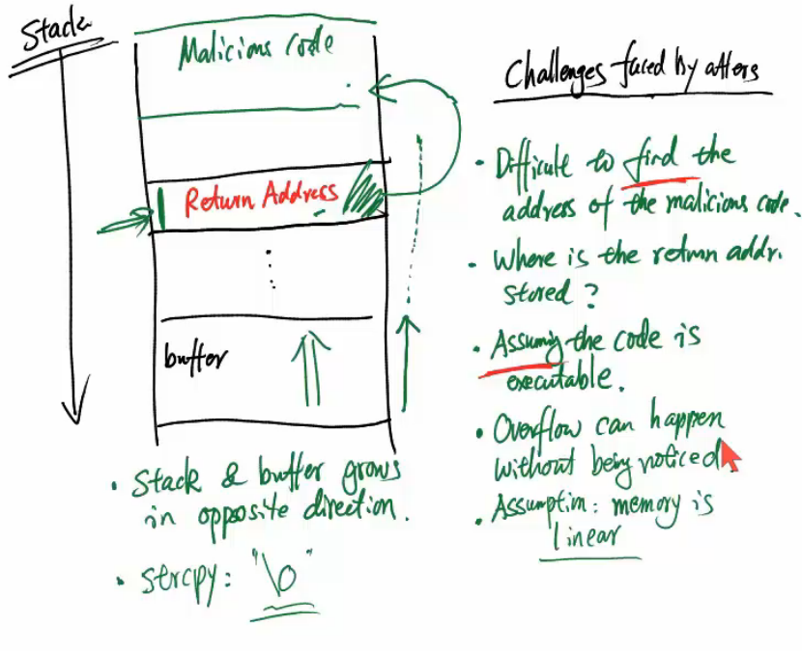

Slide 3
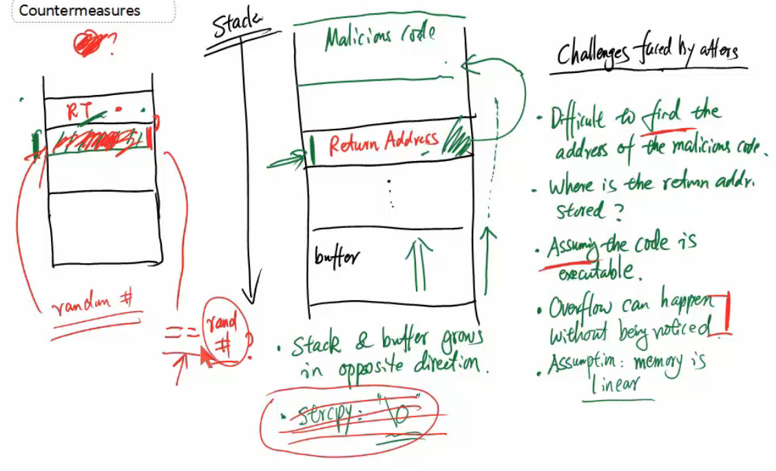
Stack Guard: Check if a low address content has been changed

Slide 4
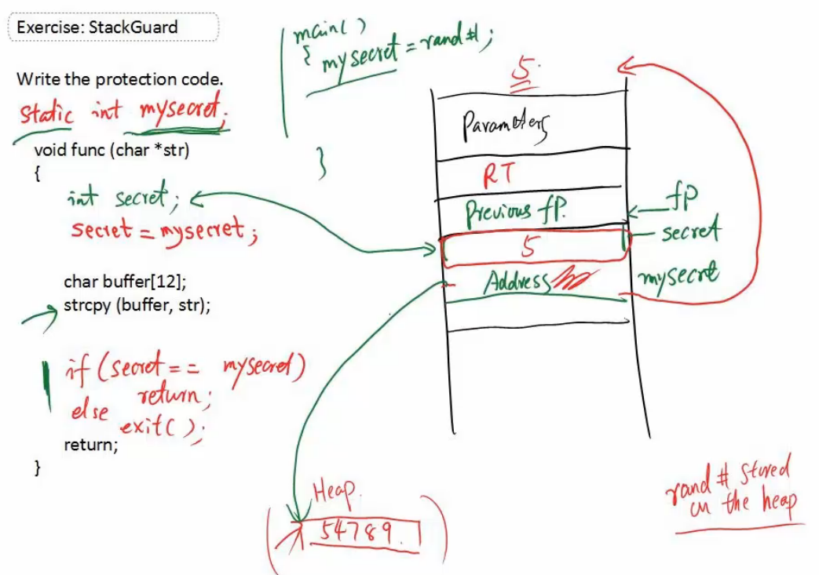

Slide 5
